Slide 1
Dimensionality Reduction
Jianlin Cheng

Slide 2
Outline
Principal Component Analysis (PCA)
Multidimensional Scaling (MDS)
Isomap
Kernel PCA
Locally Linear Embedding (LLE)
Laplacian Eigenmaps (LEM)
Sammon Mapping
Mutilayer Autoencoder
Other Nonconvex methods

Slide 3
Models
Linear methods
  Principal component analysis (PCA)
  Multidimensional scaling (MDS)
  Independent component analysis (ICA)
Nonlinear methods
  Kernel PCA
  Locally linear embedding (LLE)
  Laplacian eigenmaps (LEM)

Slide 4
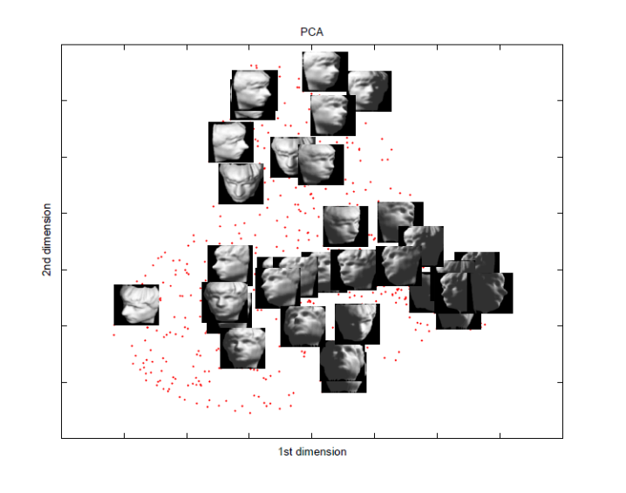
Principal Component Analysis (PCA)
History: Karl Pearson, 1901
Find projections that capture the largest amounts of variation in data
Find the eigenvectors of the covariance matrix, and these eigenvectors define the new space
x₂
e
x₁

Slide 5
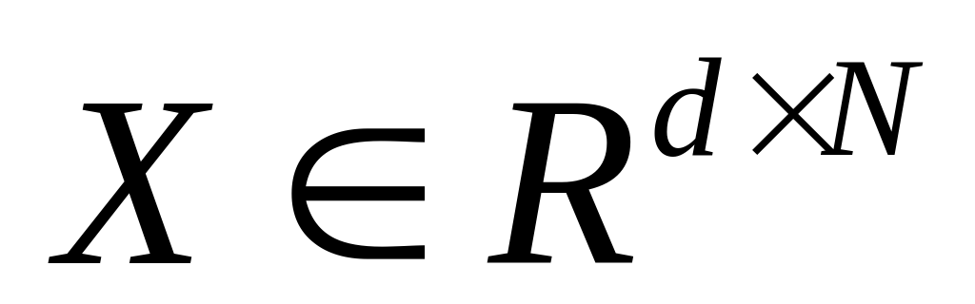
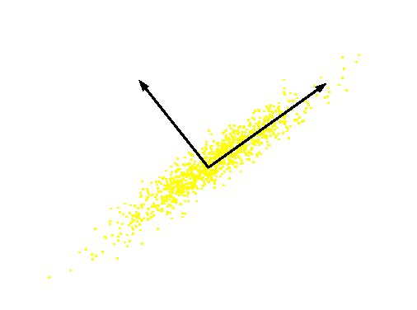
PCA
Definition: Given a set of data , find the principal axes are those orthonormal axes onto which the variance retained under projection is maximal
PC 2
Original Variable B
PC 1
Original Variable A
Notes:
方差在映射下保留能够达到最大。

Slide 6
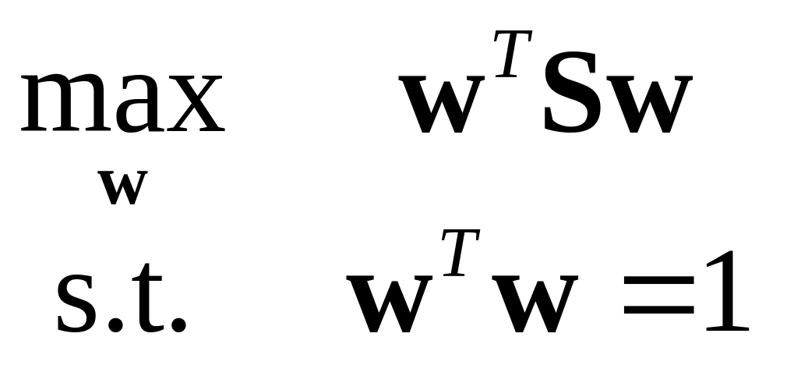
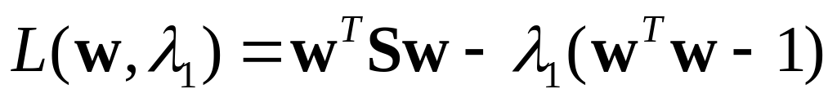
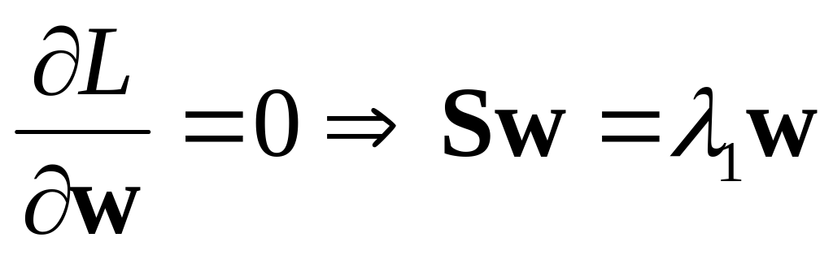
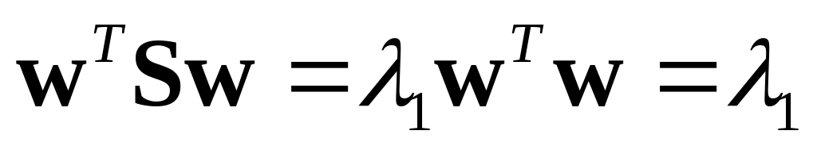
Formulation
Variance on the first dimension
  var(U₁)=var(w^{T}X)=w^{T}Sw
  S: covariance matrix of X
Objective: the variance retains the maximal
Formulation
Solving procedure
  Construct Langrangian
  Set the partial derivative on to zero
  As w ≠ 0 then w must be an eigenvector of S with eigenvalue λ₁

Slide 7
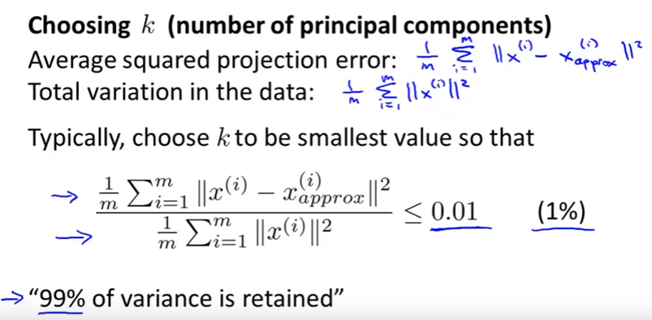
How to choose k
Notes:
方差在映射下保留能够达到最大。

Slide 8
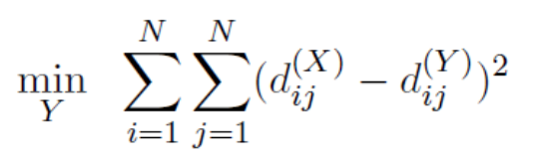

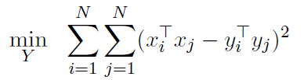
Multidimensional Scaling (MDS)
History: T. Cox and M. Cox, 2001
Attempts to preserve pairwise distances
Different formulation of PCA, but yields similar result form
Transformation
Notes:
多维标度法，降维空间和原空间的不相似程度。

Slide 9
Isomap
History: J. Tenenbaum et al, Science 1998
A nonlinear generalization of classical MDS
Perform MDS, not in the original space, but in the geodesic space
Procedure-similar to LLE
  Find neighbors of each data point
  Compute geodesic pairwise distances (e.g., shortest path ) between all points
  Embed the data via MDS
Notes:
流行结构的距离-测地线距离。

Slide 10


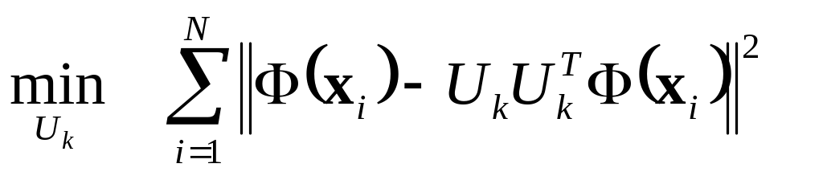


Kernel PCA
History: S. Mika et al, NIPS, 1999
Data may lie on or near a nonlinear manifold, not a linear subspace
Find principal components that are nonlinearly to the input space via nonlinear mapping
Objective
Solution found by SVD:
U contains the eigenvectors of

Slide 11
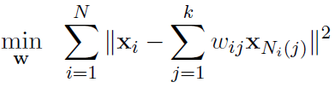
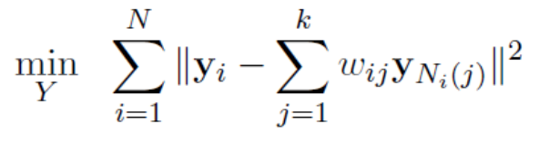
Locally Linear Embedding (LLE)
History: S. Roweis and L. Saul, Science, 2000
Procedure
  Identify the neighbors of each data point
  Compute weights that best linearly reconstruct the point from its neighbors
  Find the low-dimensional embedding vector which is best reconstructed by the weights determined in Step 2

Slide 12
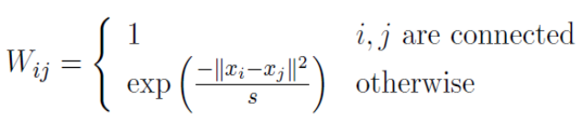
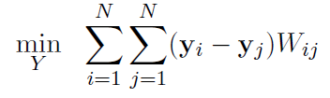
Laplacian Eigenmaps (LEM)
History: M. Belkin and P. Niyogi, 2003
Similar to locally linear embedding
Different in weights setting and objective function
  Weights
  Objective
Notes:
使在高维空间中距离比较近的点也能够得到很好的保留。

Slide 13

Sammon’s Mapping
A variation on MDS
Preserve the distances between nearby points than between those which are far apart
formulation
Notes:
多维标度法，降维空间和原空间的不相似程度。

Slide 14
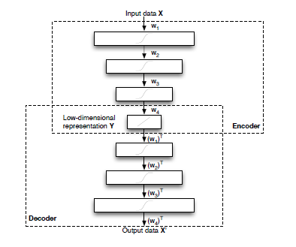
Multilayer Autoencoders
Notes:
多维标度法，降维空间和原空间的不相似程度。

Slide 15
Summary
--nonlinear techniques for dimensionality reduction are, despite
their large variance, often not capable of outperforming traditional linear techniques such as PCA
--new nonlinear techniques for dimensionality reduction required
(i) do not suffer from the presence of trivial optimal solutions
(ii) may be based on non-convex objective functions
(iii) do not rely on neighbourhood graphs to model the local structure of the data manifold
Notes:
多维标度法，降维空间和原空间的不相似程度。

